Slide 1
MmWave based Simultaneous Localization and Mapping (SLAM) for indoor robots
Krithik Lekinwala Shreya Singaraju
Supervisor: Dr Kevin I-Kai Wang

Slide 2
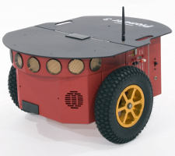
Problem
Inspiration driven from firefighters in low visibility environments
19,000 fatalities, 7,000 injuries, and 17 firefighter casualties in 2019
They need assistance for search and rescue
Research aims to explore SLAM techniques and analyse sensors
Pioneer robot [1]
1. Generationrobots.com. 2022. Pioneer 3-DX. [online] Available at: <https://www.generationrobots.com/media/Pioneer3DX-P3DX-RevA.pdf> [Accessed 9 May 2022]

Slide 3
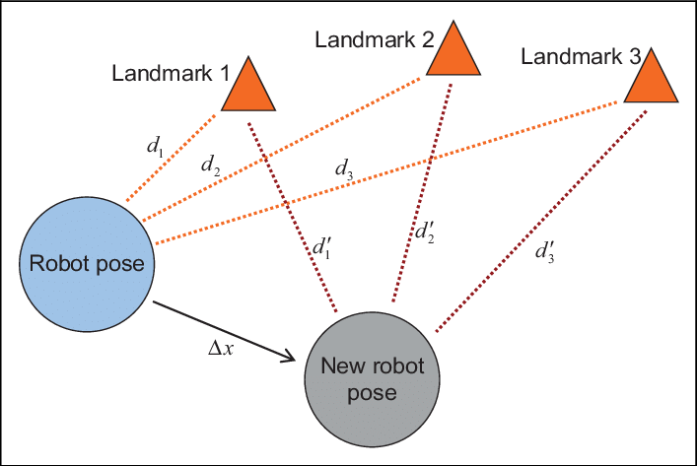
What is SLAM?
Simultaneous Localization and Mapping useful for analysing indoor areas
Iteratively updates position and area data from sensor inputs
Real-time information to detect obstacles
SLAM keeps track of position, grid map reconstruction only uses mapping
Doesn’t rely on existing data of landmarks
Diagrammatic representation of SLAM problem [2]
2. L. Xia et al., “A survey of image semantics-based visual simultaneous localization and mapping: Application-oriented solutions to autonomous navigation of mobile robots.” International Journal of Advanced Robotic Systems, vol. 1, May. doi: 10.1177/1729881420919185.

Slide 4
Sensor Analysis
Find best sensor based on factors with priority
Low range on ultrasonic for indoor, also low FoV (45 vs 180)
LiDAR inoperable in smoke
Inertial commonly used, but piles up errors
Priority: 1-5 | Effective Range (3) | Detectable information (5) | Operable in smoke (5) | Operable in low light (5) | Requires line of sight (5)
Millimeter-wave (LRR) | 175-200m [3] | Distance, velocity, angle | Yes | Yes | No
LiDAR | 200-400m | Distance, velocity, angle, light intensity | No | Yes | Yes
Ultrasonic | 10m | Distance, material type | Yes | Yes | No
Inertial | - | Velocity, angle, speed, operator location | Yes | Yes | No
3. H. Liu, “Autonomous Rail Rapid Transit (ART) systems,” in Robot Systems for Rail Transit Applications, 2020, pp. 189-234, doi: 10.1016/B978-0-12-822968-2.00005-X

Slide 5
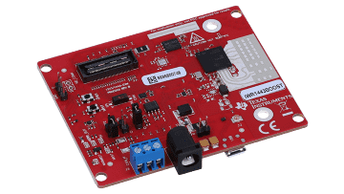
What is mmWave?
Radar-based sensor used for applications such as 5G and radar
Distance measured using wave propagation time
Collects data regardless of visibility and line of sight
Satisfies factors for our project.
Plenty of documentation
Millimeter-wave radar kit [4]
4. 2022. IWR1443BOOST. [online] Available at: <https://www.ti.com/tool/IWR1443BOOST> [Accessed 9 May 2022].

Slide 6
Existing research
mmWave is a fairly recent technology [5]
Performance of mmWave radar sensors in adverse environments has been explored
SLAM was introduced as a solution in 1995 [6]
Widely modified, developed and explored with other sensors (Lidar, Ultrasonic, Inertial, Camera)
Currently limited research exploring SLAM + mmWave
5. Rizzato, F. (2021, April 28). Quantifying the mmWave 5G experience in the US. Opensignal Limited. https://www.opensignal.com/2021/04/28/quantifying-the-mmwave-5g-experience-in-the-us#:~:text=AT%26T%20was%20the%20last%20among,the%20launch%20in%20December%202018.
6. H. Durrant-Whyte and T. Bailey, “Simultaneous localization and mapping: part I,” IEEE Robotics & Automation Magazine, vol. 13, no. 2, pp. 99–110, Jun. 2006, doi: 10.1109/MRA.2006.1638022.

Slide 7
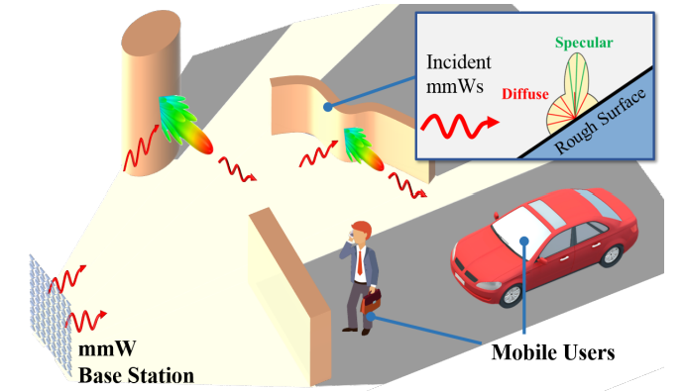
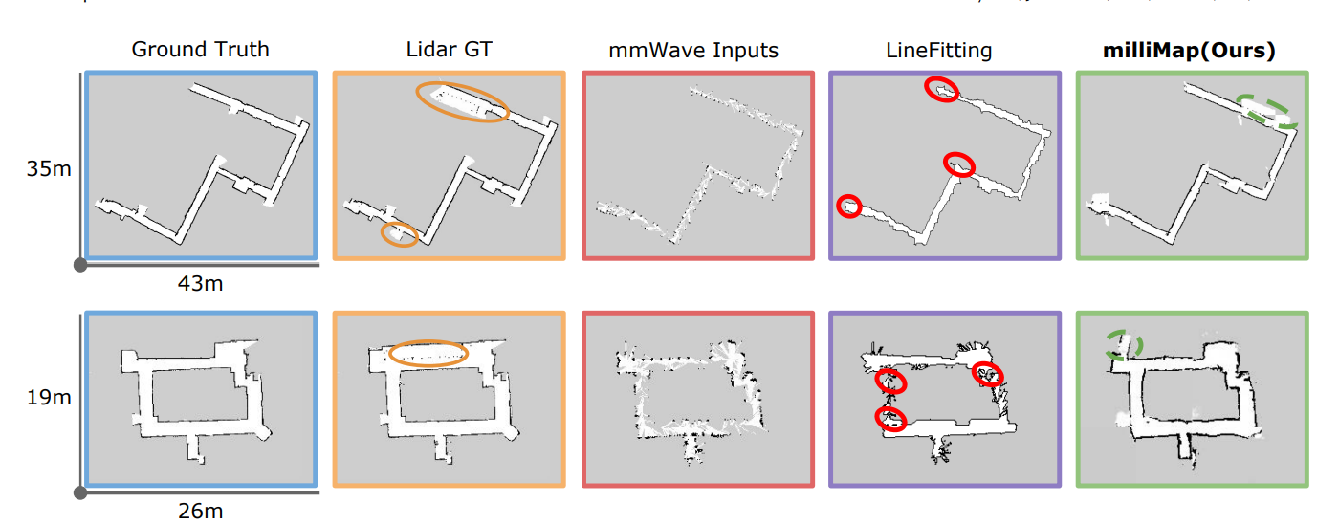
Our contribution
mmWave sensors are better suited for low-visibility environments
SLAM methods are more effective and accurate due to real-time iterative estimations
Our research will add a different approach to the limited research in this field
Explore SLAM + mmWave for path boundary mapping and object detection
 | mmWave | SLAM | Object detection | Path boundaries
Trend 1 | ✔ | ✔ | ✔ | ✖
Trend 2 | ✔ | ✖ | ✖ | ✔
Our contribution | ✔ | ✔ | ✔ | ✔
Object detection mapping [7]
Path boundary mapping [8]
7. M. Aladsani, A. Alkhateeb, and G. C. Trichopoulos, “Leveraging mmWave Imaging and Communications for Simultaneous Localization and Mapping,” in ICASSP 2019 - 2019 IEEE International Conference on Acoustics, Speech and Signal Processing (ICASSP), May 2019, pp. 4539–4543. doi: 10.1109/ICASSP.2019.8682741.
8. C. X. Lu et al., “See Through Smoke: Robust Indoor Mapping with Low-cost mmWave Radar,” in Proceedings of the 18th International Conference on Mobile Systems, Applications, and Services, Jun. 2020, pp. 14–27. doi: 10.1145/3386901.3388945.

Slide 8
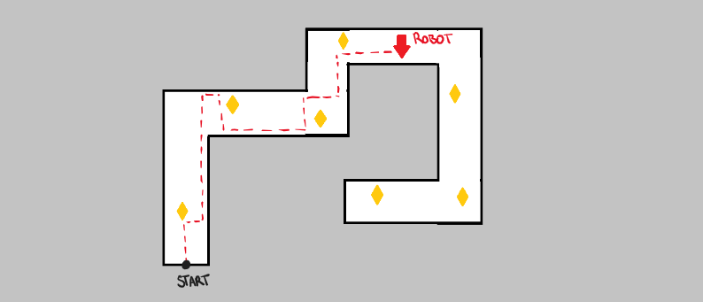
Research intent
Explore the effectiveness of using SLAM methods and mmWave technology for localization and path-mapping in indoor environments.
Develop a SLAM algorithm using mmWave sensor inputs
Mapping path boundaries and objects in unknown indoor environments
Potential to explore and implement pathfinding
Our contribution

Slide 9
Project scope & next steps
Mar | Apr | May | Jun | Jul | Aug | Sept | Oct
Literature Review |  | Early Seminar | Develop our SLAM algorithm |  |  |  | Display day poster/video
 | Research SLAM Algorithms & Implementations | Decide on a SLAM approach to pursue |  | Test implementation |  |  | Final report
 |  | Set up Indoor Robot (ROS) with mmWave Radar Kit |  | Mid-year progress video |  |  | Project Compendium
 |  |  |  |  |  |  | Display day Seminar/Demonstration

Slide 10
Q&A

